Slide 1
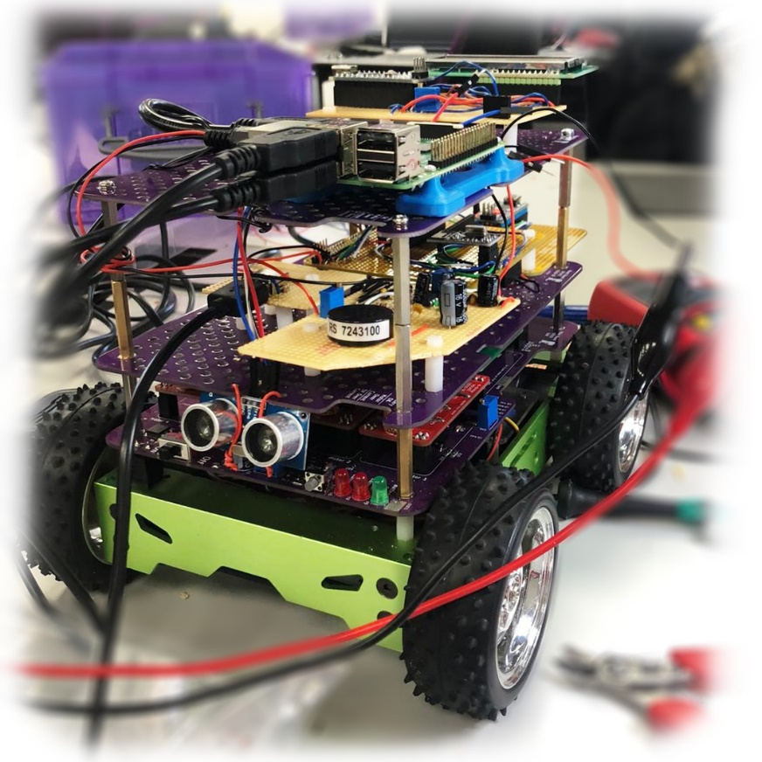
Integrated with a Raspberry Pi minicomputer, which is the decision-making part of the Kamehameha.
Eye of The Kamehameha:
Car is implemented with a SG90 Servo Control for visual detection.
Kamehameha The Sixth
Voice of The Kamehameha:
An amplifier circuit with LM386 used for audio assistance via a speaker.
Autonomy Level
2/5
Wheel of The Kamehameha:
RF Transceivers enables the car to be used via a remote joystick.
Robustness
4/5
Range Detection:
Front, back and left side of the car is equipped with HC-SR04 to measure distance to an object. Plus, enabling autonomous stopping and parking.
Performance
5/5
C0₂ Emission
0/5
Power Consumption
3/5
Brain of The Kamehameha:
Servo Control integrated with Raspberry Pi enables the car to collect data from its environment. Line and symbol detection are the main two features. Processed data is used to perform autonomous acts, where the motor control is managed by the automobile.

