Slide 1
A Cross-Adaptive Multiband Parametric Equalization Technique to Minimize Masking in Multitrack Audio
Metehan Yuksel​​
08/06/2023

Slide 2
Agenda
The Problem
A Brief Background​
Proposed Solution
Feature Extraction
Cross-Adaptive Analysis
Filter Design
Future Work
Questions
Psychoacoustics and Audio Coding
Auditory Masking, Auditory Filter Banks & Excitation Patterns
State-of-The-Art Technologies
Commonly Adapted Digital Audio FXs

Slide 3
The Problem
Independent Artists with No Technical Knowledge
Professional Audio Engineers Facing Pressure
Issues Regarding Live Venue Sound Quality
Expensive Hardware Products and Software Tools

Slide 4
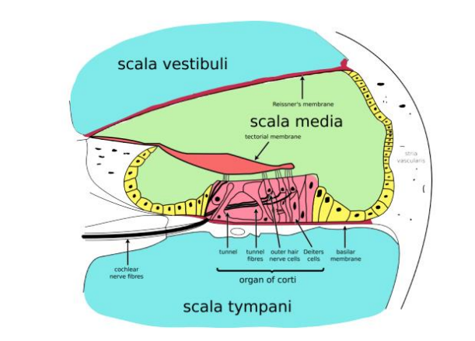
A Brief Background
Psychoacoustics and Audio Coding
Auditory Masking, Auditory Filter Banks & Excitation Patterns
State-of-The-Art Technologies
Commonly Adapted Digital Audio Effects
Cross Section of The Cochlea [1]
MPEG Audio Coding – Block Diagram [1]
The Outer Ear, The Middle Ear, The Inner Ear
Tonotopic Basilar Membrane (BM)
Spiral Architecture of Cochlea
MPEG-1 Audio Layer III (MP3) Format
Frequency Range of 20Hz – 20kHz
Imitation of The HAS’s Perception of Sound

Slide 5
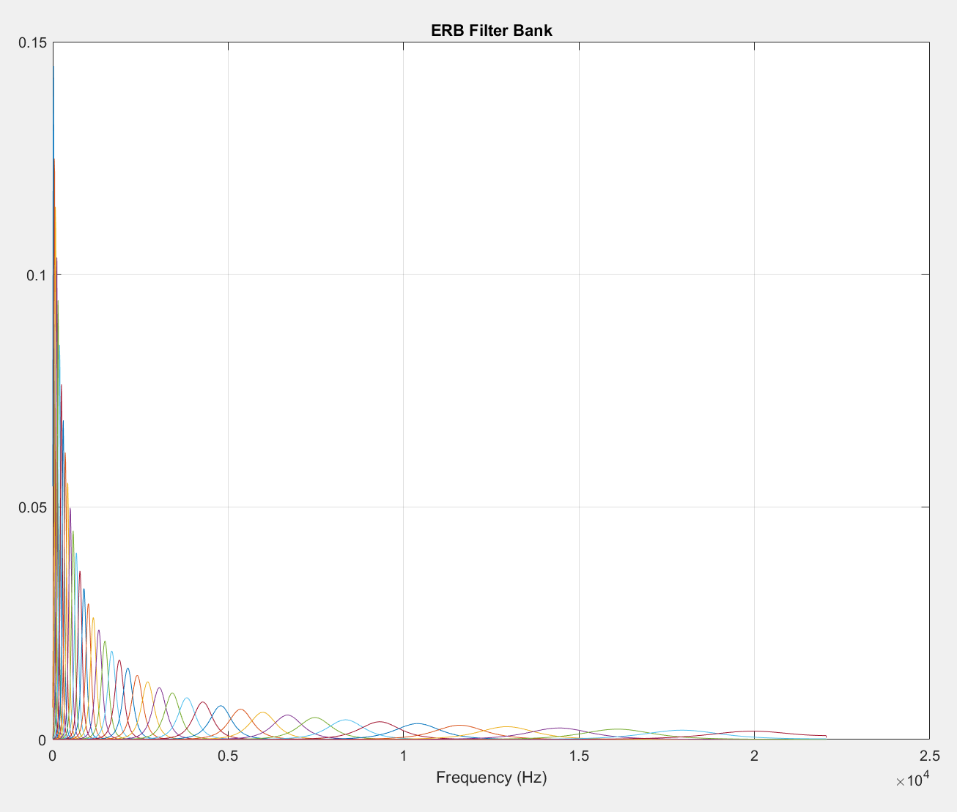
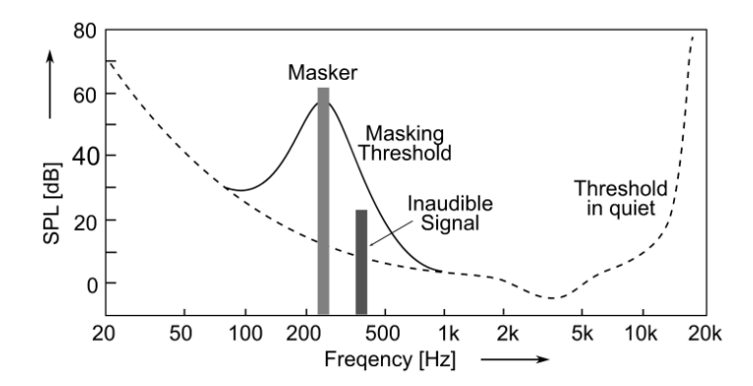
A Brief Background
Psychoacoustics and Audio Coding
Auditory Masking, Auditory Filter Banks & Excitation Patterns
State-of-The-Art Technologies
Commonly Adapted Digital Audio Effects
Spectral Masking Effect Roughly in 250Hz Band [2]
Excitation Pattern: The squared sum of the energy at the output of each auditory filter [3]. (Illustrated with excitograms)
ERB-Based Auditory Filter Bank

Slide 6
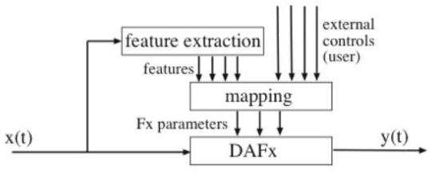
A Brief Background
Psychoacoustics and Audio Coding
Auditory Masking, Auditory Filter Banks & Excitation Patterns
State-of-The-Art Technologies
Commonly Adapted Digital Audio Effects
Real Time VS Offline Approach
ERB & Bark Scales
Autonomous & Semi-Autonomous Systems
Machine Learning & AI Assistant
User Control
General Overview of Adaptive Audio Effects (A-DAFX) [4]
ISO & IEC Standards
ISO 226
Adaptive Gating
Cross-Adaptive Audio Effects (XA-DAFX) - [MIMO Algorithms]
IIR Filter VS FIR Filter

Slide 7
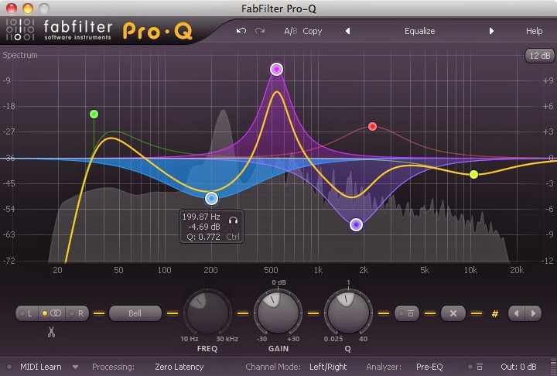
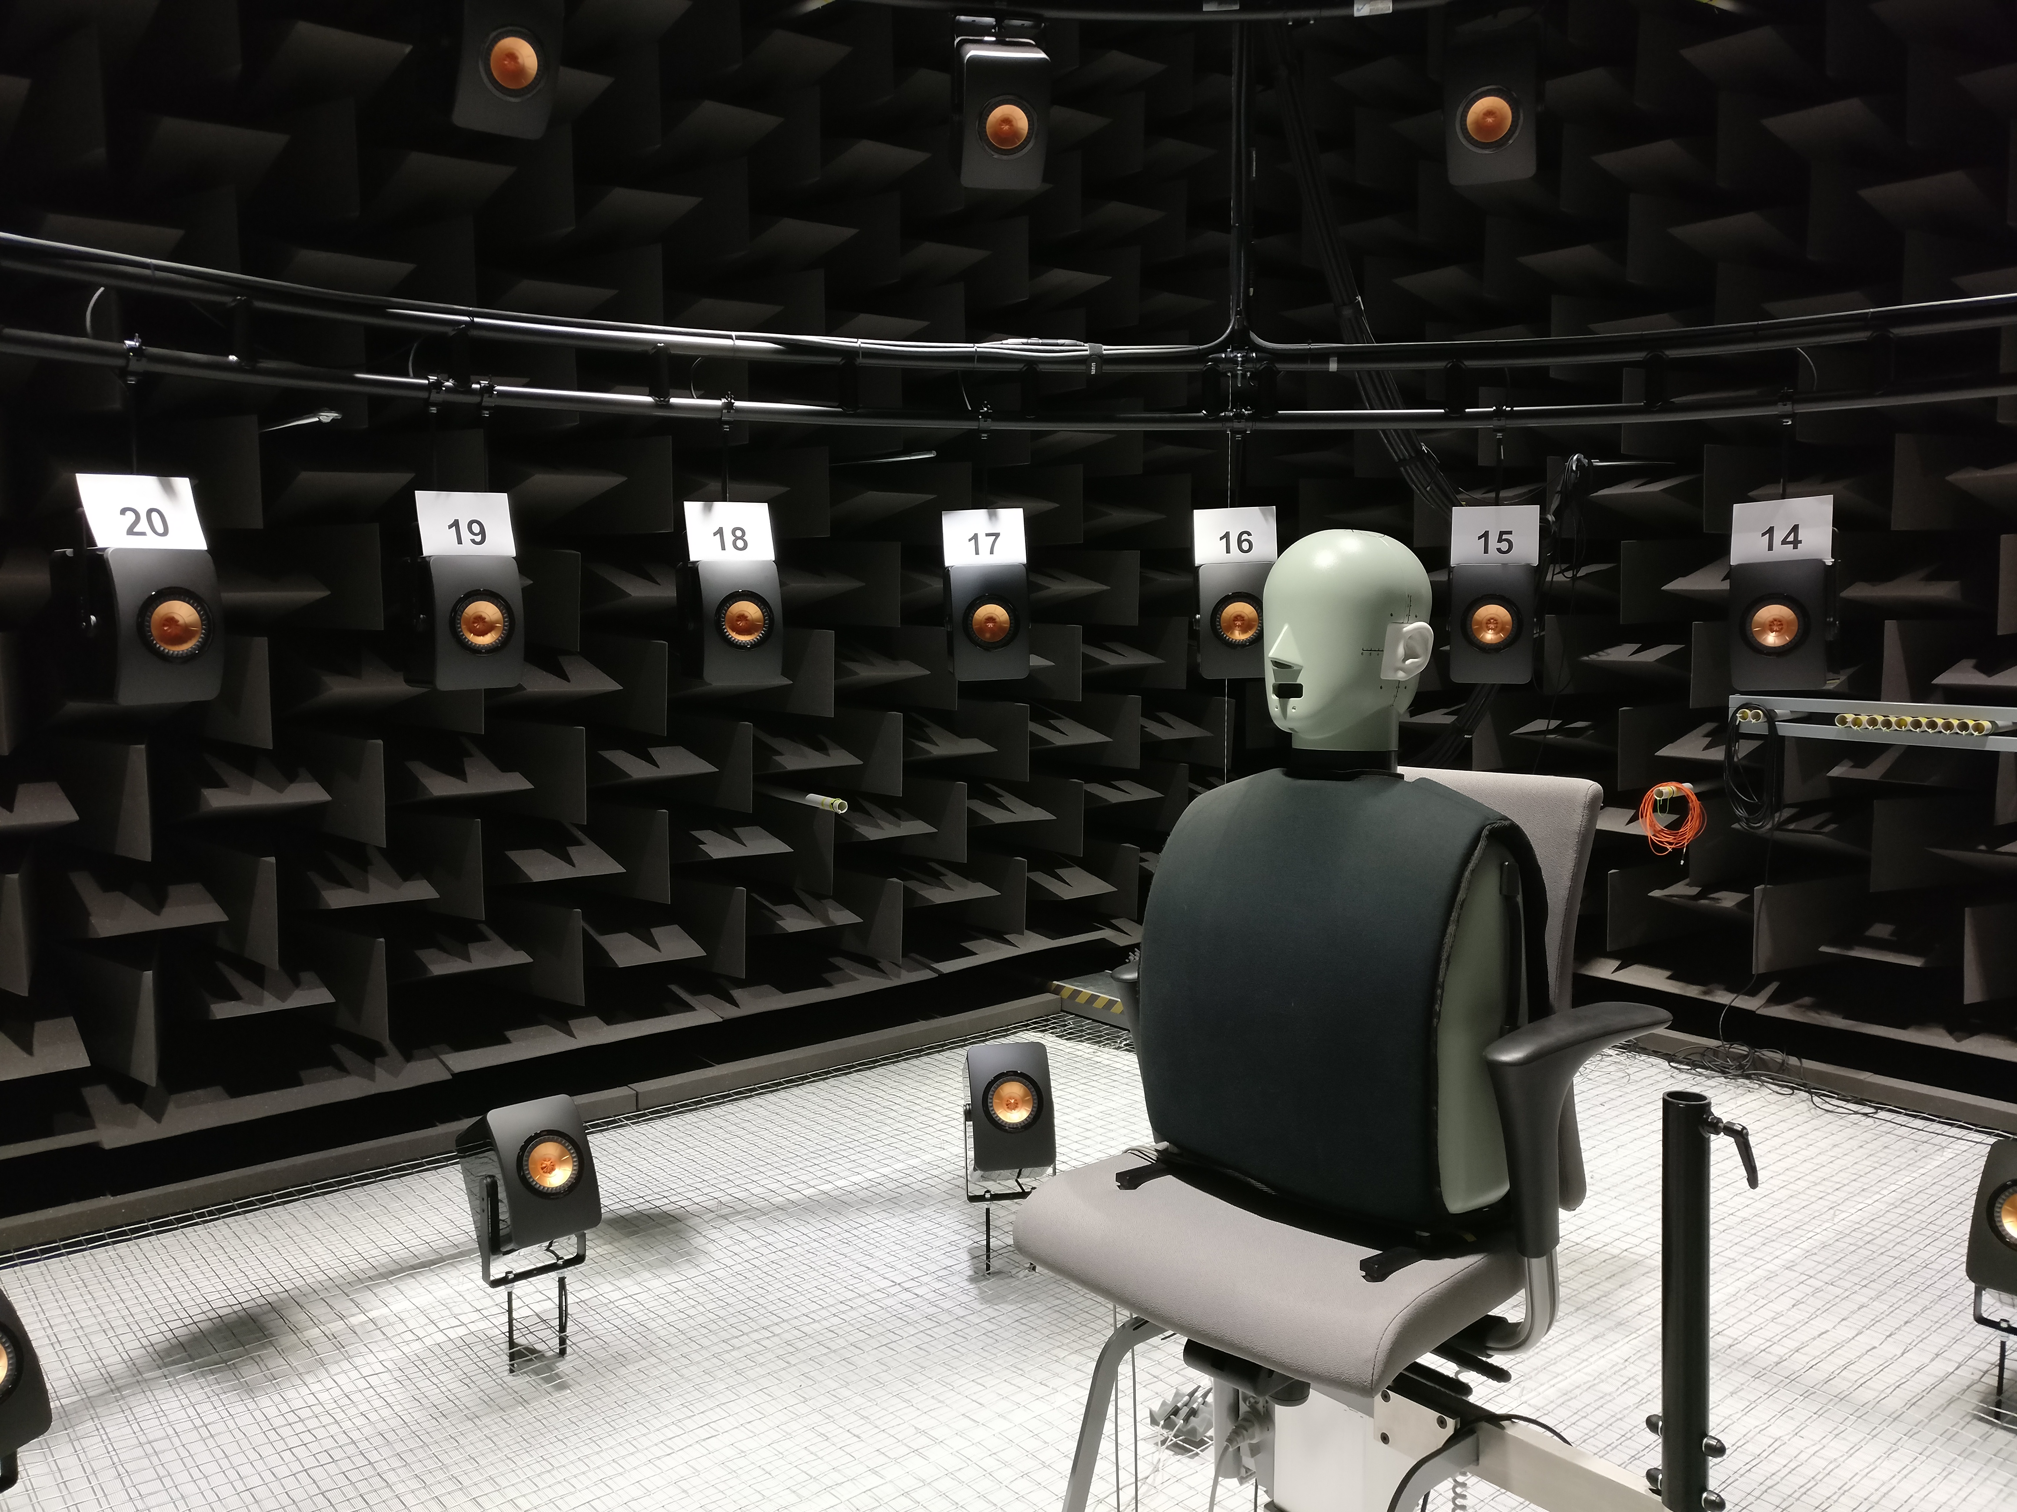
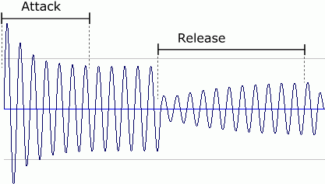
A Brief Background
Psychoacoustics and Audio Coding
Auditory Masking, Auditory Filter Banks & Excitation Patterns
State-of-The-Art Technologies
Commonly Adapted Digital Audio Effects
DYNAMIC RANGE COMPRESSOR (DRC)
EQUALIZATION
PANNING
GAIN (LEVEL)
This Photo by Unknown Author is licensed under CC BY-SA
This Photo by Unknown Author is licensed under CC BY
This Photo by Unknown Author is licensed under CC BY-NC-ND
This Photo by Unknown Author is licensed under CC BY

Slide 8
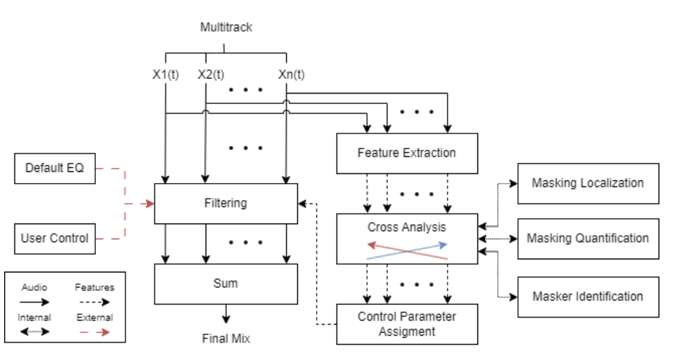
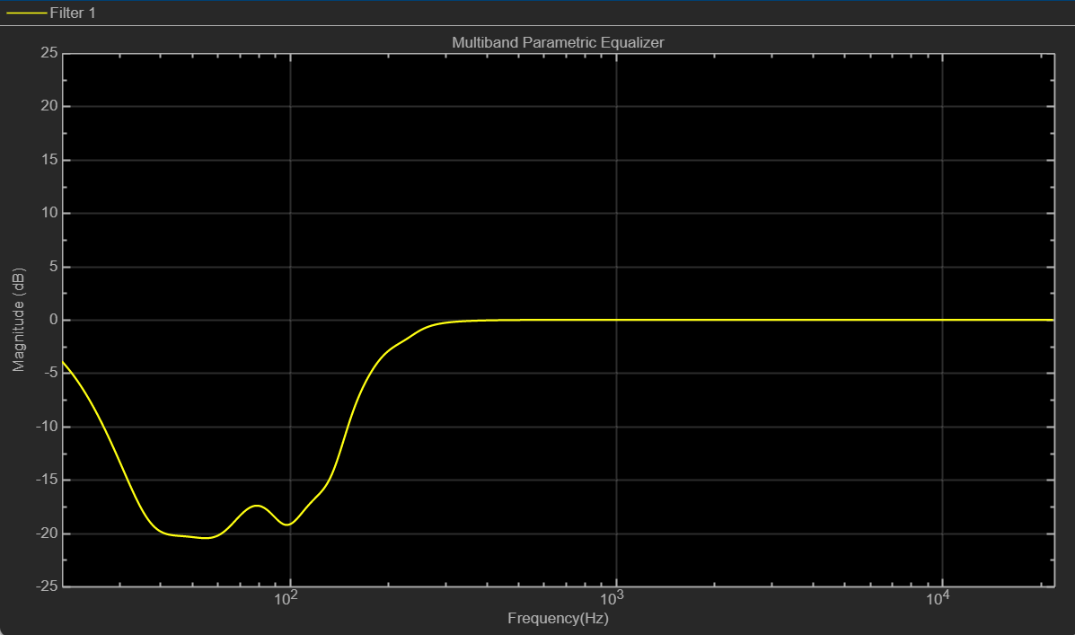
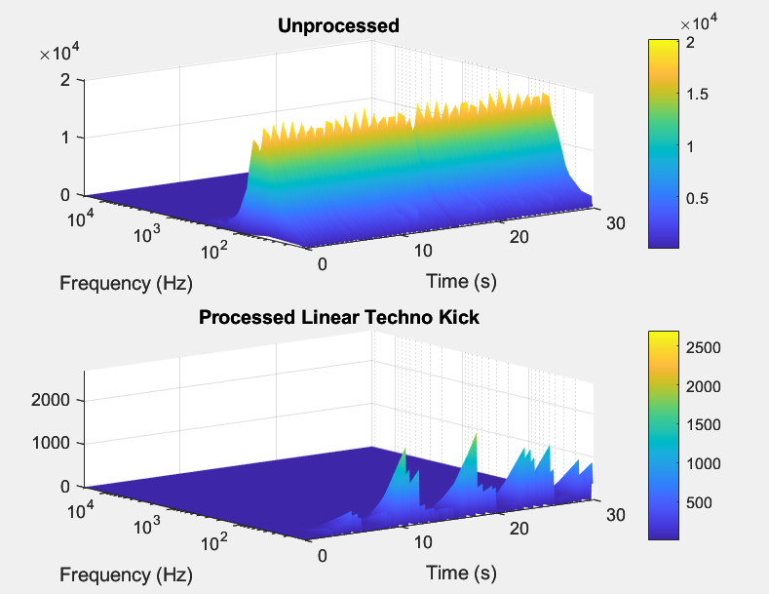
Proposed Solution
Short Time Fourier Transform
Equivalent Rectangular Bandwidth
Cross-Adaptive Analysis
Masking Identification & Quantification
Acquiring Control Parameters of Each Track
Multiband Parametric EQ Design
Applying Filter
Final Mixdown

Slide 9
Feature Extraction
Short Time Fourier Transform (STFT)
Equivalent Rectangular Bandwidth
1
Monophonic tracks, track length, number of tracks and resampling.
A multi-resolution STFT, comprising 6 parallel FFTs.
$$S_{n}\left(f, t\right)=\sum_{m=−∞}^{∞}{x_{n}\left(m\right) w\left(t−m\right) e^{−{j2πfm}/N}}$$
Windowing function, FFT size and resolution.
3D Matrices – Time, Frequency & Magnitude
2
Moore’s Equivalent Rectangular Bandwidth (ERB).
$$ERB=24.7(0.0437f+1)$$
A 42-band auditory filter bank with a spacing of 0.9953 ERB intervals between center frequencies is designed with respect to HAS frequency range (20Hz – 20000Hz).
$$S_FB(f)=S(f) ∗FB(f)$$
Excitation patterns and excitograms.

Slide 10
Cross-Adaptive Analysis
Masking Identification & Quantification
Acquiring Control Parameters of Each Track
4
Perform comparison between track pairs.
$P=N×(N−1)/2$
Localization of significant masking regions with thresholding.
$$MR_{AB}\left(f,t\right)={\left(S_{A}(f,t)×S_{B}(f,t) \right)}^{2}$$
Identification and quantification of masking in significant regions.
$$M_{AB}\left(f,t\right)=S_{A}\left(f,t\right)−S_{B}(f,t)$$
5
Deducting bandwidths (BW), centre frequencies (fc), quality factor (Q), desired attenuation (G) and masker (ID). Storing all parameters accordingly.
$$Q={fc}/{BW}$$
$G=20log10(\overline{\left|M_{AB}(f,t)\right|})$
Parameter filtering depending on track ID and sorting depending on deducted attenuation levels.
Enabling operator control of control parameters.

Slide 11
Filter Design
Multiband Parametric EQ Design
Applying Filter
6
Utilize first six parameter data sets, if less than six, refer to default parameter values. Create cascaded filters.
FIR filters provide a quick solution but are complex to create, and are prone to loss of precision, quantization and dither.
IIR filters may lead to pre-echoes and ringing of transients, but they closely mimic analogue filters.
It is desired to have low-shelf filters, and Audio Toolbox’s inbuilt function multibandParametricEQ() provides a plausible cascaded low-shelf IIR filters.
7
Control parameters are deducted according to ERB bands with significant masking, where all magnitudes at the specific band are summed and averaged over significant times of masking.
Calculated attenuation might not be accurate as it is the overall sum of instances of masking. This may lead to neglecting of instances, where the role of the masker and maskee change.
The process is straightforward; thus, filtering can be applied directly to time-domain signal, saving computational complexity as ISTFT is unnecessary.

Slide 12
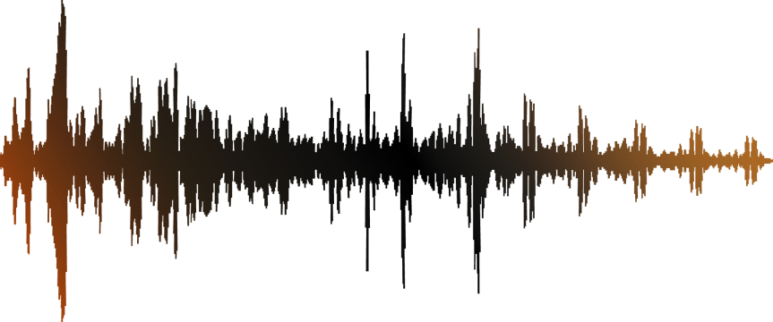
Future Work
Real Time Adaptation
Adaptive Gating & General EQing
Spatial Maximization with Opposition

Slide 13
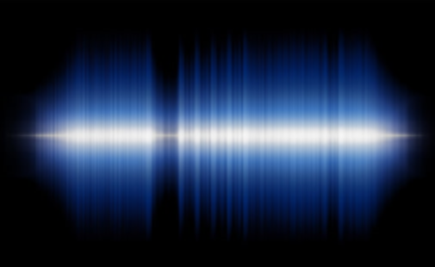
A Cross-Adaptive Multiband Parametric Equalization Technique to Minimize Masking in Multitrack Audio
QUESTIONS

Slide 14
A Cross-Adaptive Multiband Parametric Equalization Technique to Minimize Masking in Multitrack Audio
TOOLS & RESOURCES
CPU & Testing Headphones
AMD Ryzen 7 6800HS Creator Edition
Beyerdynamic DT770 Pro 250-ohm
SOFTWARE
MATLAB
TEST DATA SOURCE
Multitrack Database of Cambridge Music Technology - Mixing Secrets For The Small Studio (Additional Resources)
PRIMARY SOURCE
Joshua D. Reiss (Centre for Digital Music at Queen Mary University of London)

Slide 15
A Cross-Adaptive Multiband Parametric Equalization Technique to Minimize Masking in Multitrack Audio
PROJECT RISKS & LIMITATIONS
Potential overload of CPU that can result with software crashing (some artists may not have access to high-powered CPUs) – Memory Loss Concerns.
Time taken to process multitrack (some CPUs can take hours) – Heating Concerns.
Lack of high-quality multitrack datasets and academical articles that are publicly available – Limitations on Information, Data and Testing.

Slide 16
A Cross-Adaptive Multiband Parametric Equalization Technique to Minimize Masking in Multitrack Audio
CHALLENGES FACED
Opposition panning methodology was the initial approach, and this method required a more complex process. For example, phase of signals became a concern and inter-channel correlation (similarity index) was essential to decide on opposition.
Deciding on Short Time Fourier Transform and ERB Filter Bank parameters had to be adjusted during the development, which lead to repetitive testing.
Establishing cross-adaptive algorithm and storing the values took longer than anticipated.
Was unable to extract time-varying masking functions specific to track pairs.
Timing problems due to poor planning of academic terms.
Not enough time to establish user interface (semi-autonomous nature)

Slide 17
A Cross-Adaptive Multiband Parametric Equalization Technique to Minimize Masking in Multitrack Audio
CONVOLUTION & CORRELATION
Convolution: Most used with the impulse response of a system to show how a signal is modified by passing through that system. The convolution of two signals in time is equal to the multiplication of their spectra.
$$DFT\left(x⊛y\right)=X(k)Y\left(k\right)$$
Correlation: Correlation is a measure of how similar two signals are - are the signals the same shape in the same time period?
Inter-Channel Correlation – Similarity Index [5]
Track Subgrouping

Slide 18
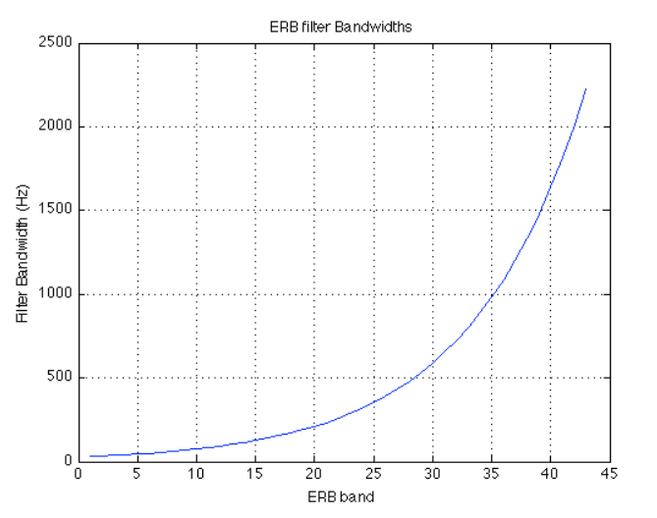
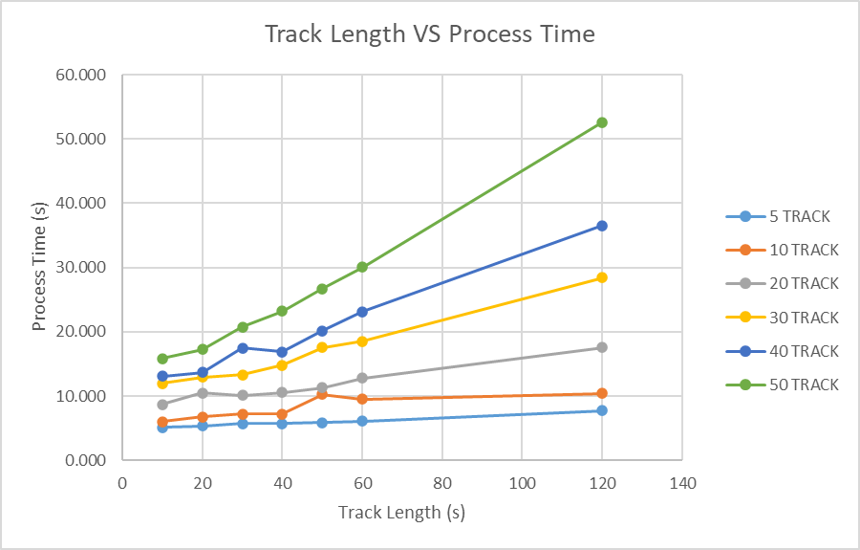
A Cross-Adaptive Multiband Parametric Equalization Technique to Minimize Masking in Multitrack Audio
ADDITIONAL
ERB bandwidth against band number [3]
Variation of Track Length Against Process Time with Increasing Number of Tracks

Slide 19
A Cross-Adaptive Multiband Parametric Equalization Technique to Minimize Masking in Multitrack Audio
REFERENCES
Cofer, B. H. (2019). "An Analysis of Perceptual Masking between Stems in Manually-Mixed Multitrack Audio using a Cross-Analytic Loudness Model." Master of Science in Audio Engineering (MSAE) thesis, Belmont University, Nashville, TN. 4. https://repository.belmont.edu/msaetheses/4
J. Herre and S. Dick, “Psychoacoustic Models for Perceptual Audio Coding—A Tutorial Review,” Applied Sciences, vol. 9, no. 14, p. 2854, Jul. 2019, doi: 10.3390/app9142854.
S. Vega and J. Janer, “QUANTIFYING MASKING IN MULTI-TRACK RECORDINGS,” in Proceedings of SMC Conference , Barcelona, Spain, 2010, pp. 1–8.
S. Vega Lopez, “Content-based Processing for Masking Minimization in Multi-track Recordings,” PDF, Universitat Pompeu Fabra, 2010.
C. Avendano, and J. Jot, "A Frequency-Domain Approach to Multichannel Upmix," J. Audio Eng. Soc., vol. 52, no. 7/8, pp. 740-749, (2004 July.). doi:

